Slide 1
Laptop Market Intelligence System for Price Segmentation Using Machine Learning
S. KRISHNA KUMAR
DADS – JULY COHORT A

Slide 2

Introduction
The laptop market is rapidly growing with diverse configurations, creating challenges in understanding market positioning based on specifications. This project addresses the need for data-driven pricing and segmentation, applying machine learning techniques on real-world e-commerce data to provide actionable insights for both buyers and sellers.

Slide 3
Laptop market growth and challenges
The expanding laptop market presents difficulty for consumers to assess value and for sellers to price competitively. Diverse specifications and price fluctuations hinder clear market understanding, necessitating an analytical approach to segment laptops effectively by price categories for improved decision-making.

Slide 4

Need for data-driven pricing segmentation
Manual pricing evaluations are inefficient and inconsistent. Implementing data-driven price segmentation supports objective classification of laptops based on technical and market features, enabling transparent and dynamic pricing strategies that reflect real market demand patterns.

Slide 5
Project Objectives
Data Collection and Preparation: The project aims to collect, clean, and preprocess laptop specification and pricing data to build a reliable dataset for analysis and modeling.
Price Prediction:
Using supervised machine learning techniques, the objective is to predict laptop price categories based on key features such as RAM, storage, processor, and brand.
Product Segmentation:
Using unsupervised clustering techniques, the project identifies distinct laptop segments based on similarities in specifications and pricing.
Model Evaluation:
To evaluate and compare multiple machine learning models in order to select the best-performing model for accurate prediction and analysis.

Slide 6
Objective of machine learning application
The aim is to leverage machine learning to identify natural market segments through clustering and develop a supervised model to accurately predict laptop price categories. This approach enables an automated, scalable pricing intelligence system for enhanced market analysis.

Slide 7
Data Handling

Slide 8

Data collection from Flipkart via web scraping
Data was collected via web scraping of Flipkart laptop listings, including specifications, pricing, discounts, and user reviews. This real-world, unstructured data forms the basis for analysis, capturing a wide range of products across different brands and price points.

Slide 9
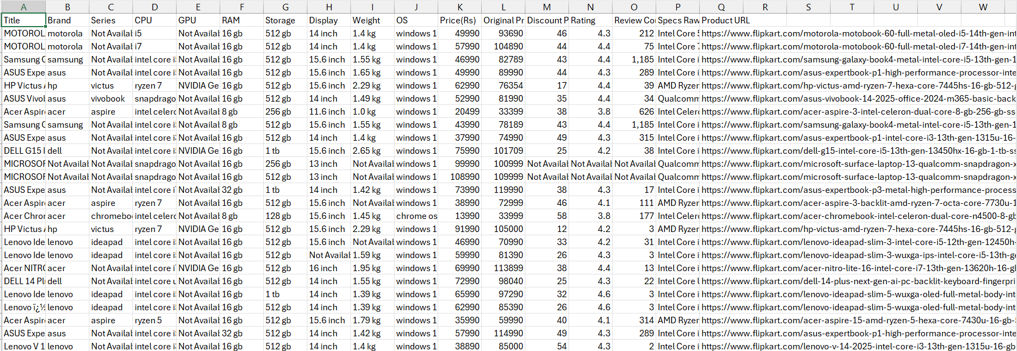
Data collection from Flipkart via web scraping

Slide 10
Data cleaning and preprocessing techniques
The dataset underwent cleaning by imputing missing values and standardizing units of measurement. Inconsistent records were removed, and categorical variables were encoded for modeling. These preprocessing steps ensured data consistency and reliability for subsequent machine learning tasks.

Slide 11
Feature engineering and selection
Feature engineering involved segmenting laptops into distinct price categories including budget, mid-range, and premium. Numerical features were standardized for modeling, and irrelevant data such as URLs and raw text were removed. This careful selection focused on key technical specifications and market attributes to ensure optimal model performance and relevance.

Slide 12
Machine Learning Models

Slide 13
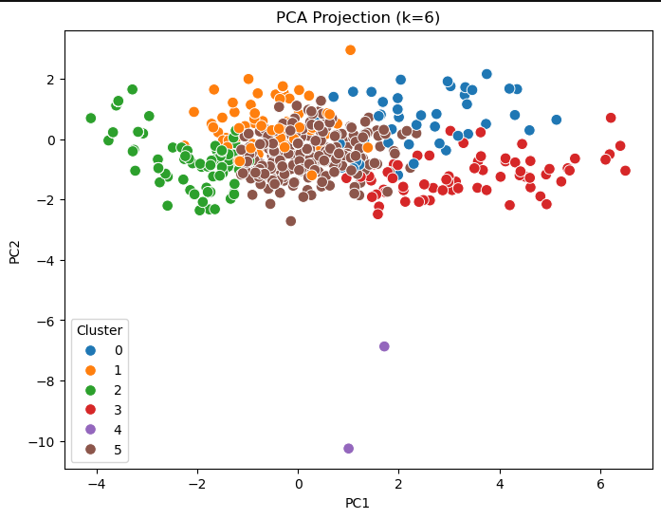
Unsupervised learning with clustering methods
K-Means clustering was employed to uncover natural groupings within the laptop data. The optimal cluster count was determined through the Elbow Method and Silhouette scores. Principal Component Analysis (PCA) was used for visualization, revealing clear separations that aligned with budget, mid-range, and premium market segments.

Slide 14
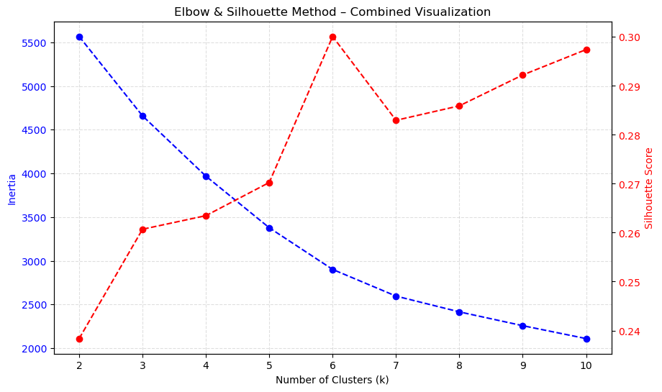
Elbow & Silhouette Analysis (Cluster Selection)
The Elbow Method shows a noticeable reduction in inertia up to K = 6, after which improvements become marginal, indicating diminishing returns.
The Silhouette Score reaches its peak around K = 6, suggesting better cluster separation and cohesion at this point.
Combining both metrics, K = 6 provides an optimal balance between compact clusters and clear separation.
This validates the selection of six clusters for effective laptop market segmentation.

Slide 15
Supervised classification with Random Forest
The Random Forest Classifier was utilized for price category prediction. This algorithm was selected for its robustness against noise, capacity to model non-linear relationships, and reduced risk of overfitting. It effectively classified laptops into appropriate price segments by leveraging the engineered features.

Slide 16
Model evaluation and persistence
The model was validated using a train-test split, achieving strong accuracy especially for mid-range and premium classes. After validation, the full model, along with preprocessing components like scalers and encoders, was saved to enable consistent and efficient future predictions without retraining.

Slide 17
Deployment and Impact

Slide 18
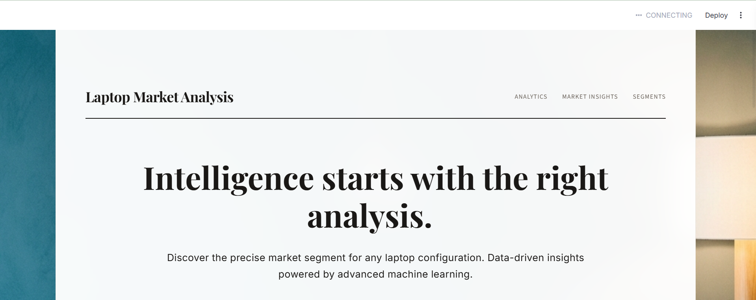
Streamlit app for real-time predictions
An interactive web app was developed using Streamlit to allow users to input laptop features and receive real-time price category predictions. The app includes dynamic feature selection based on brand and provides an intuitive user experience for buyers and sellers looking for pricing insights.

Slide 19

Business implications for buyers and sellers
This system automates price segmentation, helping buyers identify good value laptops and assisting sellers in setting competitive prices. It enhances market transparency and supports data-informed decision-making to improve pricing strategies and customer satisfaction.

Slide 20
Limitations and future enhancements
Current limitations include reliance on historical scraped data and limited feature scope from listings. Some price segments overlap, impacting precision. Planned improvements involve integrating real-time data, adopting advanced models like XGBoost and deep learning, deploying cloud-based APIs, and building recommendation systems.

Slide 21
Conclusions
The project successfully demonstrated an end-to-end machine learning approach, converting real-world laptop data into actionable market intelligence. It combined exploratory data analysis, clustering, supervised learning, and practical deployment, offering a scalable and effective solution for automated laptop price segmentation.

Slide 22


